Slide 1
Asexual Reproduction in Plants

Slide 2

By the end of this Smart Lesson you should be able to:
1. | State how many parents are involved in asexual reproduction.
2. | Describe how the offspring produced by asexual reproduction compare to their parents.
3. | State what vegetative propagation is.
4. | Describe some advantages and disadvantages to asexual reproduction compared to sexual reproduction.

Slide 3


Slide 4

In asexual reproduction there is only one parent
In asexual reproduction one plant makes new plants all by itself. So there is only one parent plant.
The offspring produced are just like their parent. We call these offspring clones.
But what do we mean when we say the offspring are just like their parents?

Slide 5

Recap: Sexual Reproduction
Well, to understand this you need to know a little bit about the other type of reproduction: sexual reproduction.
In sexual reproduction there are two parents. The offspring inherit a combination of their parents' traits, and end up slightly different from both parents!
For example, if you cross a red-flowered rose with white-flowered rose, their offspring have pink flowers!

Slide 6

Asexual reproduction
In asexual reproduction, the offspring inherit all of their traits from one parent and end up just like them!
So when a red-flowered rose reproduces asexually, their clonal offspring will have red flowers!

Slide 7
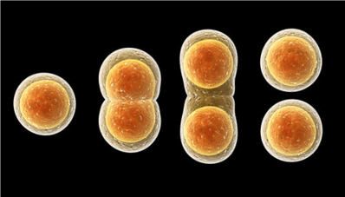
Asexual reproduction uses a type of cell division called mitosis
In mitosis, one cell splits itself in half to produce two new, identical cells. These cells then go through mitosis again to make even more cells.
This continues until, eventually, there are enough cells to make a whole new plant!

Slide 8

Mitosis is also used for growth
A plant grows taller, or adds new limbs, by making new cells through mitosis.
So when a plant reproduces asexually, it basically grows a whole new plant by making new cells!

Slide 9
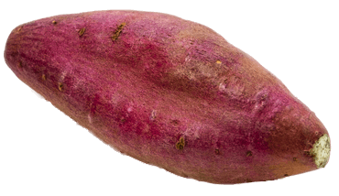
Plants can reproduce asexually through the process of vegetative propagation
One way plants can reproduce asexually is through vegetative propagation.
Plants undergo vegetative propagation by making special structures out of their roots, stems or leaves.
Different species of plants make different structures. Some examples of structures include tubers, bulbs and runners.

Slide 10
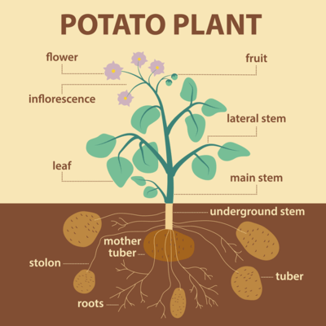
Examples of vegetative propagation: Potatoes
These structures may sound foreign, but you already have many of them in your kitchen!
Potatoes for instance are the tuber of a plant. If you put a potato in the ground, it will grow into a whole plant. As the plant becomes larger, it will make more potatoes. Eventually, these potatoes will sprout roots and stems and become their own plants!
So by making tubers, one potato plant makes more plants.

Slide 11
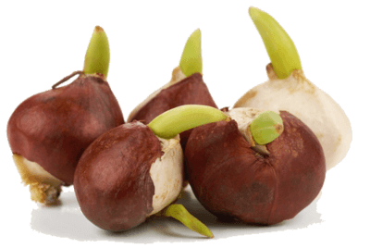
Examples of vegetative propagation: Onions
Onions are another example of a structure used in vegetative propagation. They are called bulbs.
If you plant an onion it will grow into a plant. This plant will produce more bulbs, each of which can grow into another plant!
If you garden, you probably know a few other plants that make bulbs. These include tulips, daffodils and lilies.

Slide 12

Examples of vegetative propagation: Strawberries
If you have ever grown strawberries you will know what a runner is.
Runners are stems that grow along the ground. At different places along the stem, roots are put down and a new plant grows up.
You can then cut the runner to separate the new plant from its parent. This is an easy way to make lots of new strawberry plants!

Slide 13
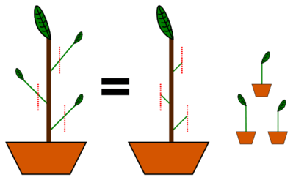
Plant cuttings
You can also force a plant to reproduce using cuttings.
You cut a piece of stem off of the plant, dip it in rooting hormone and then put it in the ground. It grows roots, using mitosis, and becomes a new plant.
This is one way to propagate certain trees and shrubs, such as roses.

Slide 14
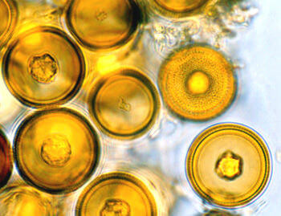
Some plants can asexually reproduce through spores
Some plants, such as ferns and mosses, use another type of asexual reproduction that uses spores.
Spores are very small. One spore is made up of only a single cell!
To protect themselves from the elements, spores have a durable outer coating.

Slide 15
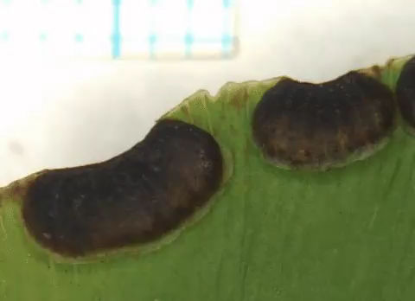
Spores can grow into a new plant in the right conditions
Being so small, spores are easily transported by the wind, water or even animals.
They travel far from their parent plant. When they land in a suitable location, they germinate and grow into a new plant.

Slide 16
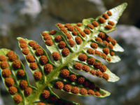
One plant makes lots of spores
One plant will make many spores! Together, they look like a powder.
You can see them on the underside of a fern. They are also in the top of little stalks that grow out of moss.

Slide 17
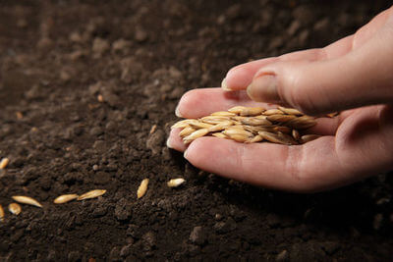
Do not confuse spores and seeds.
Seeds are the result of sexual reproduction. You learnt about them when learning about flowers and pollination. Spores are a tool for asexual reproduction.
Seeds are also much larger than spores! They are made up of many cells. One spore is made up of only one cell.

Slide 18

Advantage of asexual reproduction
Asexual reproduction is easier to do than sexual, since it does not require a partner.
Remember, sexual reproduction requires two parents. For a plant to reproduce sexually it will need another plant to reproduce with.
This can be difficult if individual plants are far apart, or if there is a lot of competition.

Slide 19

Advantage of asexual reproduction II
It can also take a lot of energy to make the structures necessary for sexual reproduction, such as the flowers, pollen, seeds and fruits.
Sometimes it is more efficient to reproduce asexually.

Slide 20
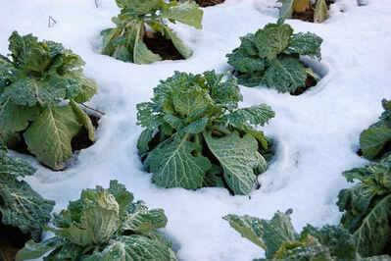
Disadvantage of asexual reproduction
However, asexual reproduction has a major drawback.
It is risky to have all your offspring be identical to one another.
If the environment changes, and the traits those offspring have are not favourable in the new environment, then they can all die!

Slide 21

Advantage of sexual reproduction
In comparison, sexual reproduction produces offspring that are all a little different from one another.
If the environment changes, there is a good chance that at least one of these offspring will have traits suited to the new environment.
So some of the offspring will survive!

Slide 22
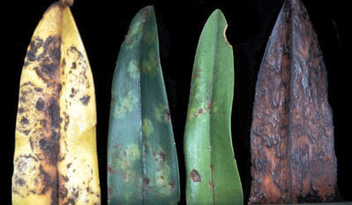
A disease could wipe out a population that reproduces asexually
For example, imagine a disease spreads through a population. Some individuals are susceptible to the disease and some are resistant.
If you reproduced asexually, all of your offspring will be identical and they may all be susceptible to the disease. In this case you could lose all of your offspring!
However, if you reproduced sexually, some of your offspring will be susceptible and some will be resistant. So some will survive!

Slide 23
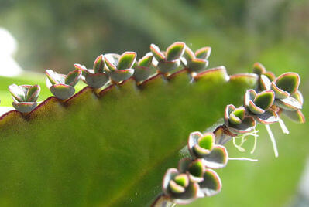
Summary of the advantages and disadvantages of asexual and sexual reproduction
Overall, asexual reproduction is easier and less energetically expensive than sexual. However, it is also riskier. It puts all your eggs in one basket by making offspring that are identical to one another.
Sexual reproduction makes offspring with different traits, and so spreads the odds around. This makes sexual reproduction favourable in unpredictable and changing environments.

